Slide 1


Expending MAM Principles to the Characterization of Cell-based Therapies
Camille Lombard-Banek, Kerstin Pohl, Edward J. Kwee, Sumona Sarkar, John T. Elliott, and John E. Schiel

Slide 2
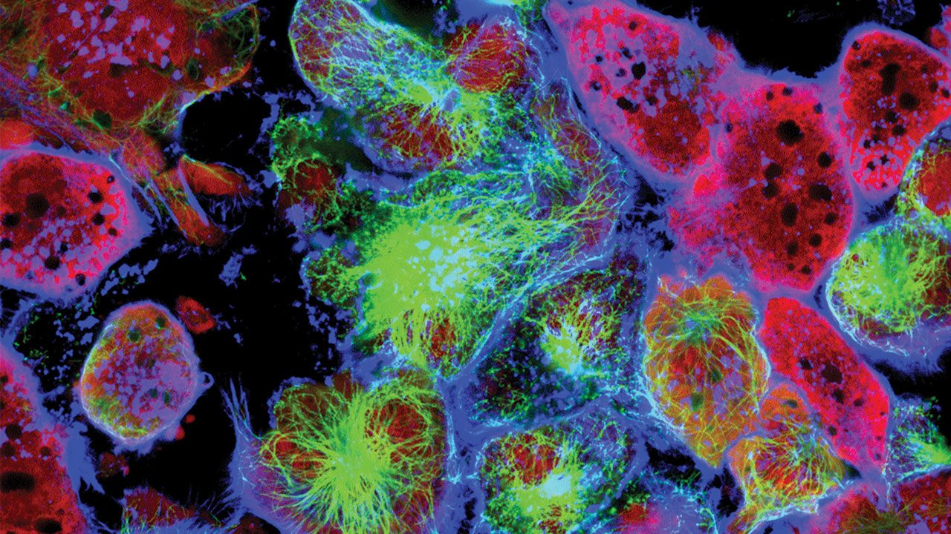
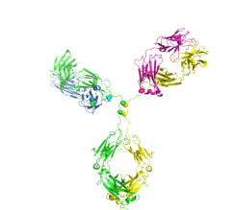
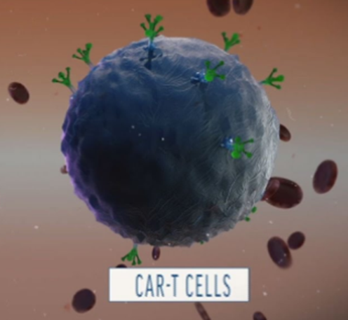
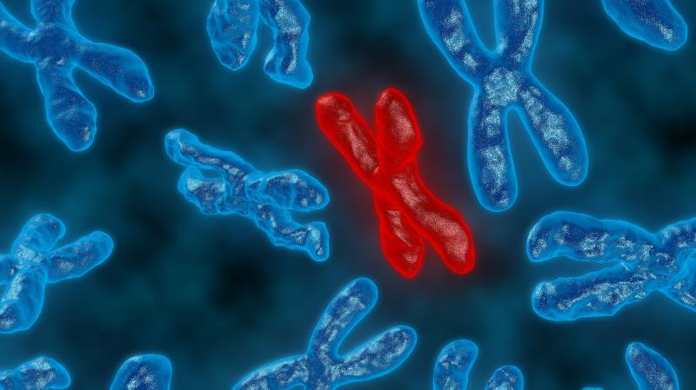

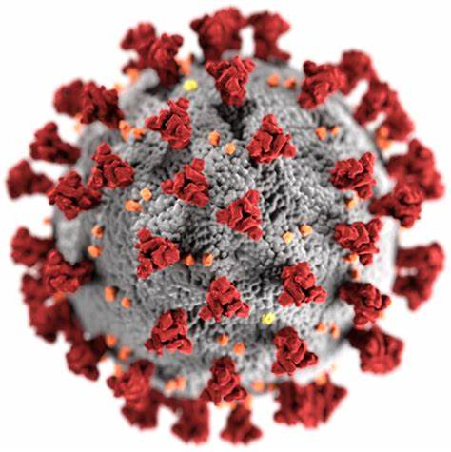
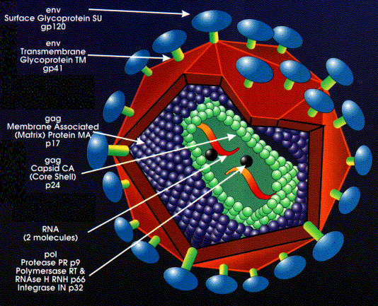
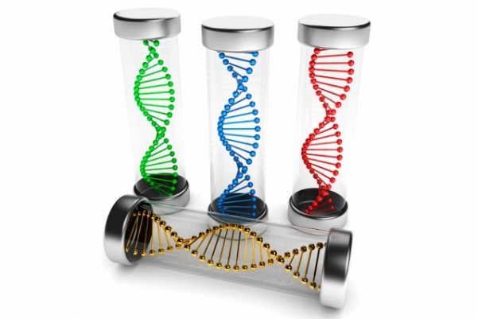
The role of NIST in advancing biomanufacturing
Measure to
Understand and Diagnose
Measure to
Accelerate & Improve
Treatment Options
Cancer
NIST
Measurement Tools &
Reference Materials are central to Innovation & Quality
mAbs
Cell Therapies
Genetic
Disorders
Gene Therapy & Viral Vectors
RNA Vaccines
SARS COV-2
Notes:
Known biological threats and ailments have not gone away and new threats such as Zika, Covid, etc. are emerging. Thankfully the arsenal of modalities to treat these illnesses is evolving with an equally unprecedented pace. We have gone from small molecules to antibodies to harnessing the actual threat (e.g. virus) as a tool in it’s own demise! To imagine that we would be potentially using an adenoviral vector to vaccinate against another virus (SARS COV-2) is astonishing.
The old adage in woodwork and building is to measure twice and cut once. Metrologists know full well, however, that nothing less than triplicate will do. In addition, we can only observe and improve what we can measure, and that measurement must be both accurate and precise.
To this end, the NIST biomanufacturing program is dedicated to accelerating measurement technologies to better understand the critical attributes of a successful therapeutic product. We develop innovative measurement tools, adapt and improve existing tools, and develop reference materials to fuel those efforts.
NIST continues to evolve with the landscape of changing treatment modalities.

Slide 3
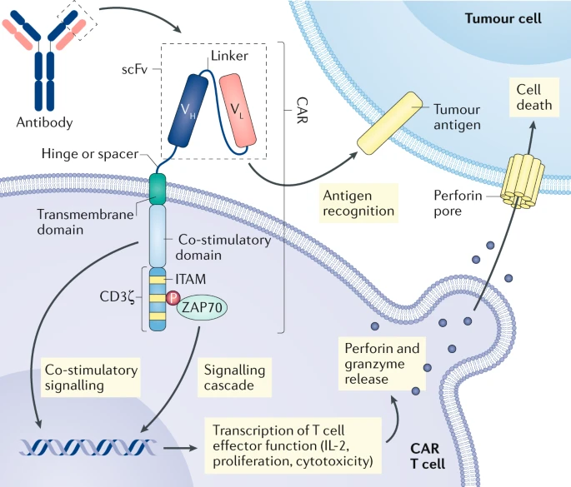
What are CAR T-cells?
Engineered T-cells to target circulating cancer cells
  Autologous: T-cell from the patient
  Allogenic: T-cell from a donor
3 FDA approved therapies (all autologous)
Larson, R.C., Maus, M.V., Nat Rev Cancer, 21, 2021

Slide 4


Opportunities and challenges for proteomics on CAR T-cells
PK & PD evaluation
Toxicity monitoring
MoA
Infusion
T-cell isolation
& Expansion
T-cell Purity
T-cell MQAs
T-cell
Virus
Transduction
Expansion
Gene vector MQAs
Effect on the T-cell biology
Success rate of transfection
% of CAR expressing cells
Effect on CAR-T cell biology
Success rate
% of CAR expressing cells
CAR T-cell
Lombard-Banek, C. & Schiel J.E., Molecules, 2020
Notes:
Add a slide about what CAR T is → Slide with CAR T killing cancer cell

Slide 5
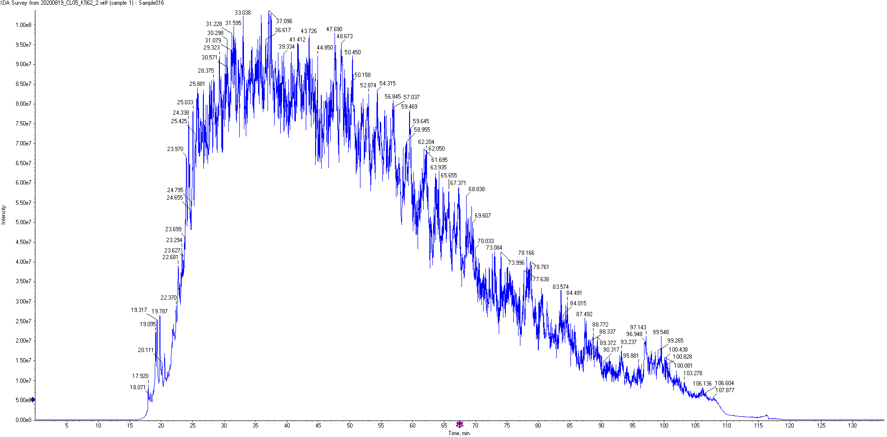
Expanding MAM principles to CAR T-cell therapies
Secreted
1 protein → 200 peptides
Historical product knowledge
Not limited in quantities
NISTmAb as system suitability
Live cell → Complex material extraction
“Active ingredient” = membrane protein
10,000+ proteins → 10⁶ peptides
Limited starting material
No system suitability available

Slide 6
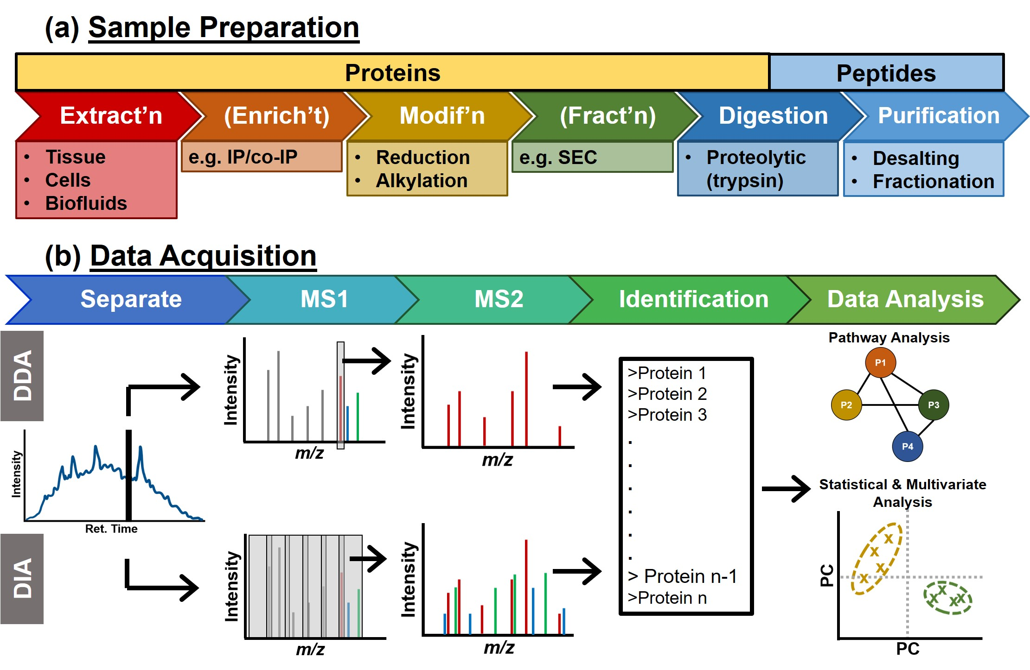
Requirements for large-scale proteomics implementation for the analysis of CAR T-cell therapies
Amenable to small protein input
→ Scalable
Detect peptides from the CAR protein
  → Efficient extraction of membrane proteins
Detect protein changes
  Sensitive
  Broad proteome coverage
High quantitative reproducibility
Proper instrument controls in place
Lombard-Banek, C. & Schiel J.E., Molecules, 2020

Slide 7
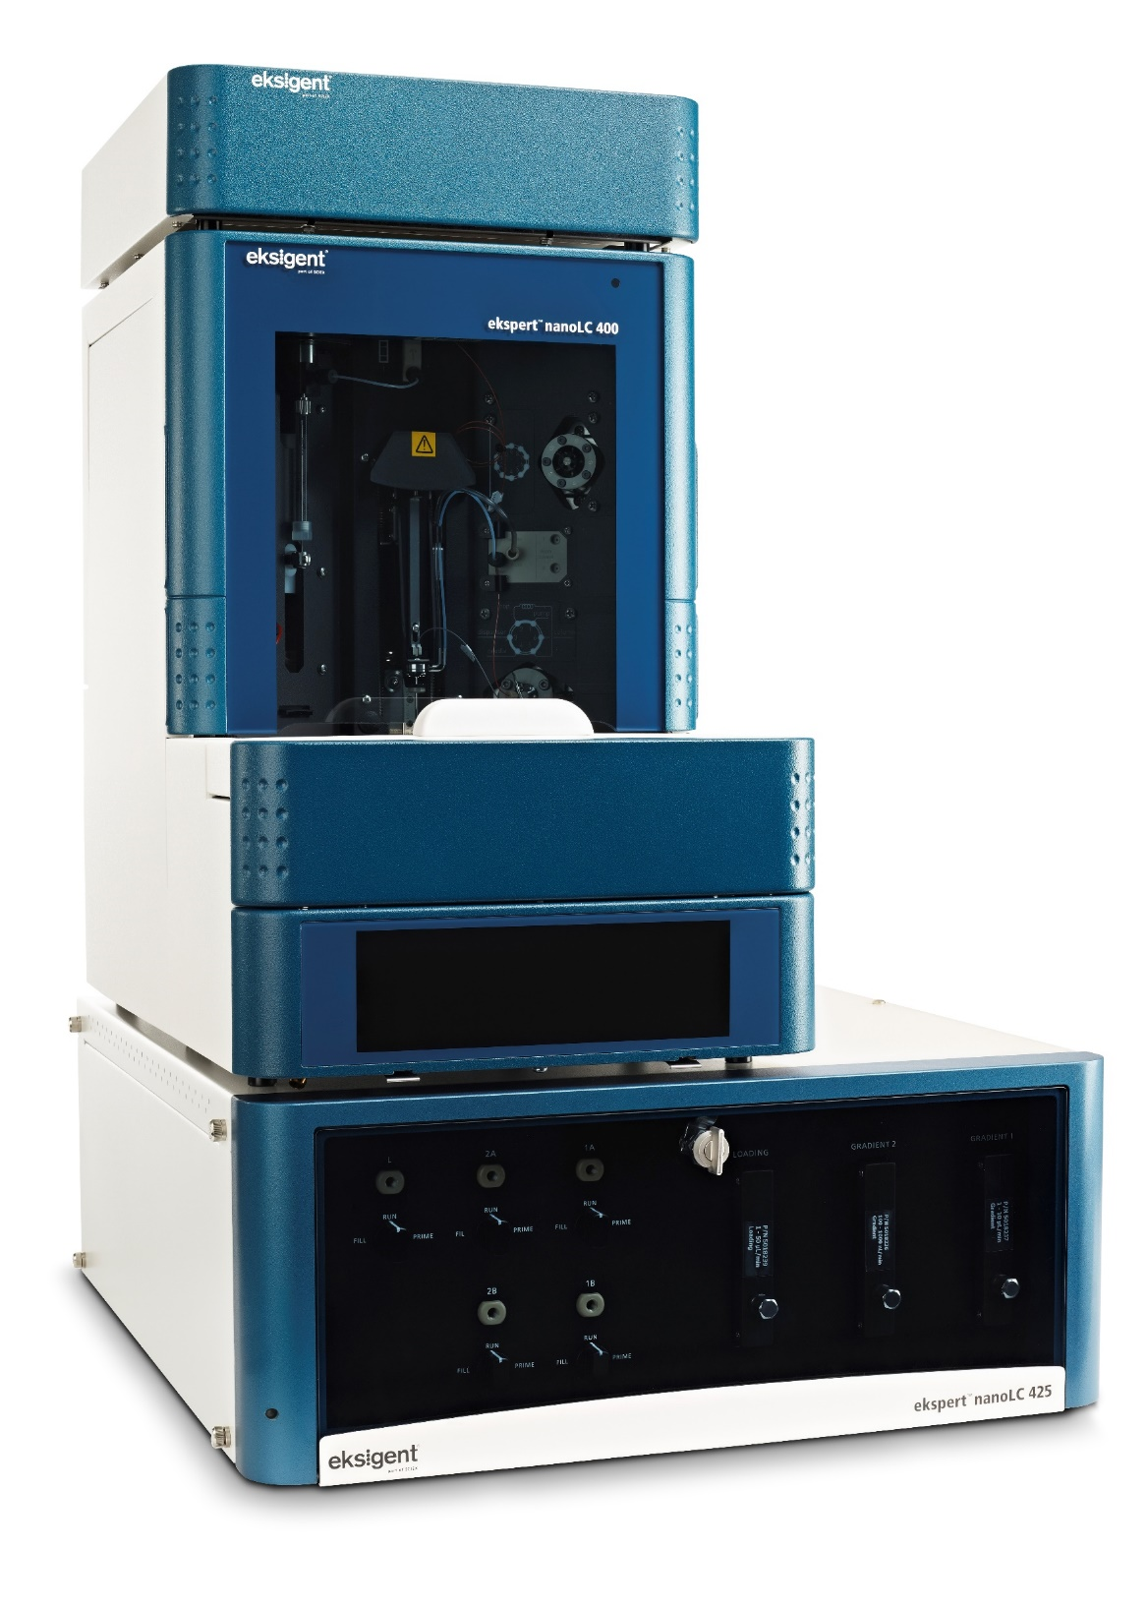
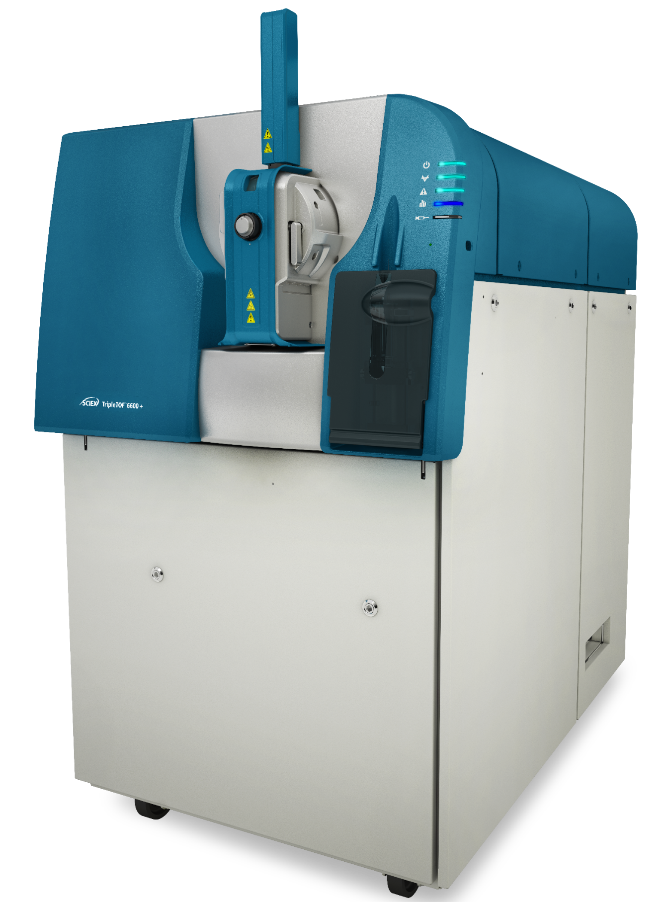
Workflow for large-scale proteomics implementation for CAR T-cell therapies
TripleTOF® 6600+ LC-MS/MS System
OptiFlow® Turbo V
Ion Source
NanoLC™ 425 HPLC System
Revisions done on a commercial K562 digest
Lombard-Banek, C. & Schiel J.E., Molecules, 2020

Slide 8



Designing a sensitive and controlled acquisition method for CAR-T proteomics
Mass Spectrometry
DDA
TOF-MS
MS/MS
IQ Metrics
Chromatography
s
Peptide Mix (e.g. PepCal)
FWHM
Ret. Times
Mass accuracy
Column:
Particle size
Length
m/z
m/z
PC
Acc. time & # Precursors
Col. energ. spread
m/z
Gradient duration
Complex Digest (e.g. K562)
Protein ID
Quant. performances
K562
SWATH®
m/z
m/z
SWATH window scheme

Slide 9
Evaluating different columns to test selectivity and performances
Column | Vendor | Particle size (µm) | Pore size (A) | Length (cm)
1 | A | 3 | 120 | 15
2 | B | 3 | 300 | 15
3 | C | 1.7 | 130 | 15
4 | C | 1.7 | 130 | 25
5 | C | 1.7 | 300 | 25
Metrics to evaluate:
Number of peptide identified
Types of peptides identified
Number of proteins quantified
Quality of quantification (e.g. %CV)
→ Use commercial K562 digest
Notes:
Again some bullets. Why different columns? I like the idea of presenting that we know going in that chromatographic performance and stationary phase selectivity will undoubtedly results in different peptide IDs. We were curious as to how this might differ and whether the totality of evidence from multiple runs could or should be harnessed. Then later when tou show that different columns did have different peptide IDs, the CAM-T data merger tool (Collated Acquisition Management Tool) was written.

Slide 10
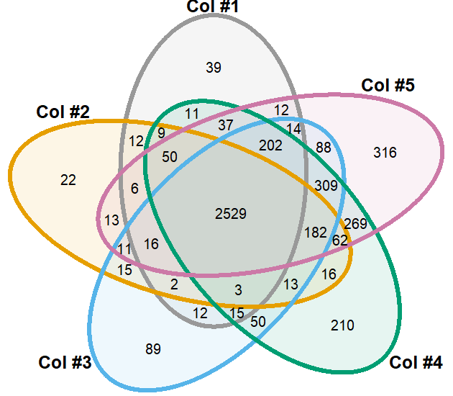
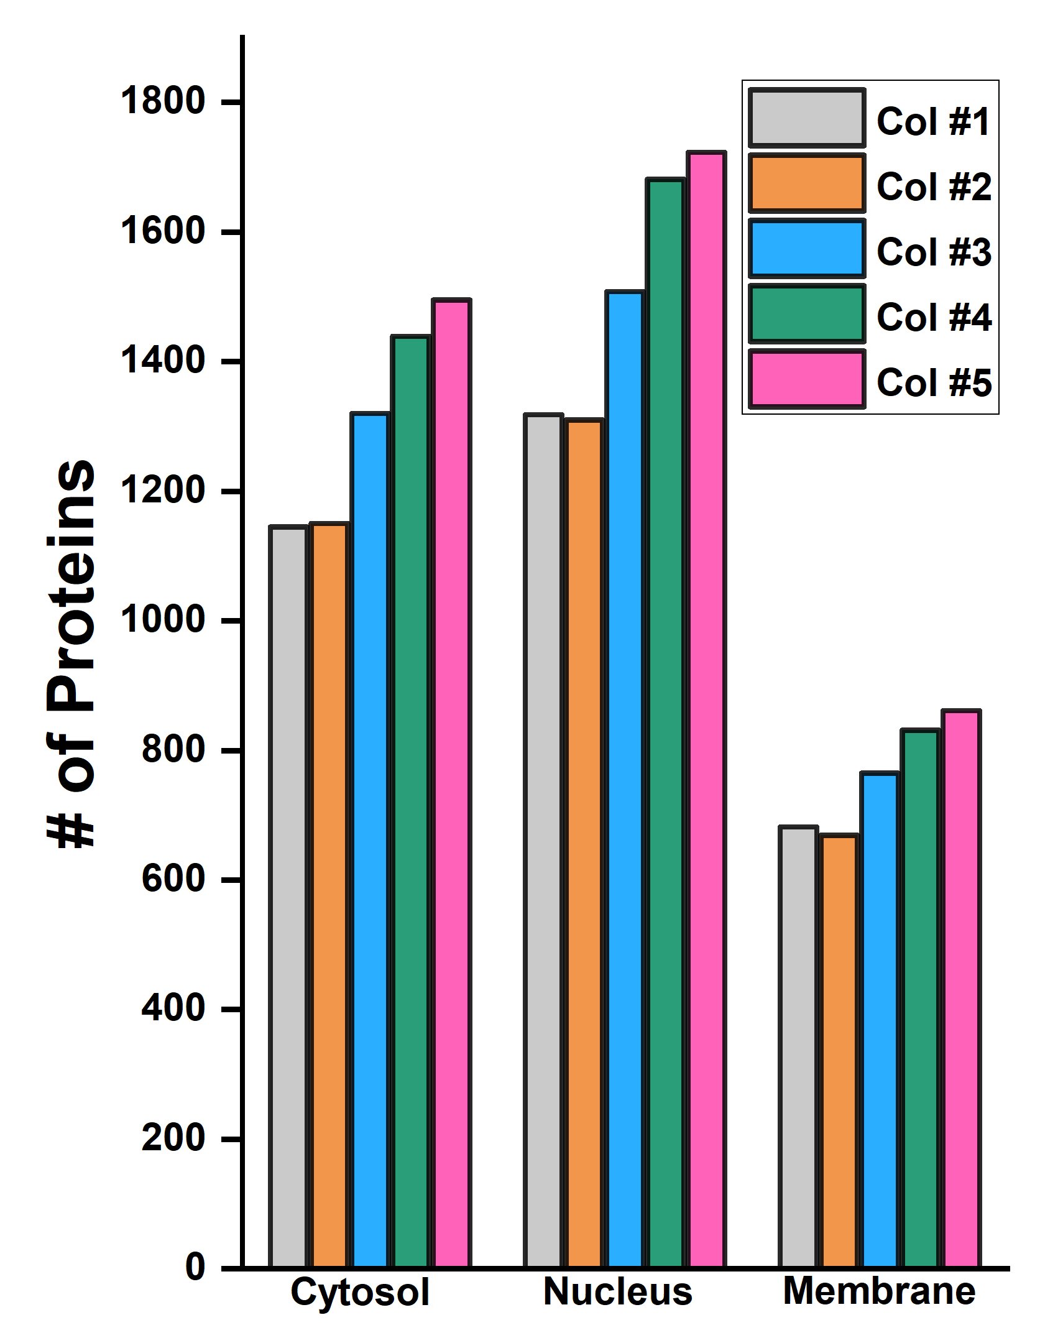
Comparison of the proteins identified with the different columns

Slide 11
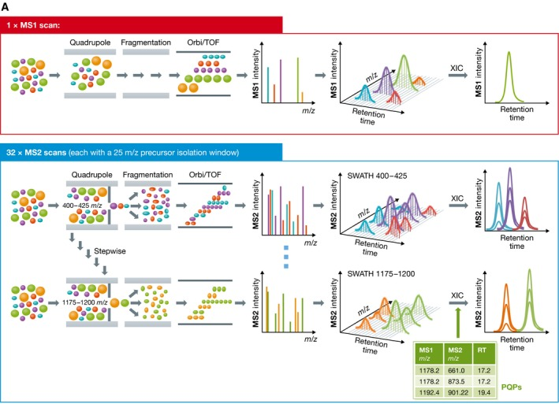
Protein quantification from SWATH® Acquisition
Low number of missing values
High dynamic range
Provides a library for future targeted assays
Ludwig, C, Aebersold R. et al., Mol Syst Biol. 2018 Aug; 14(8): e8126.
Notes:
Good for quant
“all ion” allows comprehensive proteome coverage
Dynaic range?
Other?

Slide 12
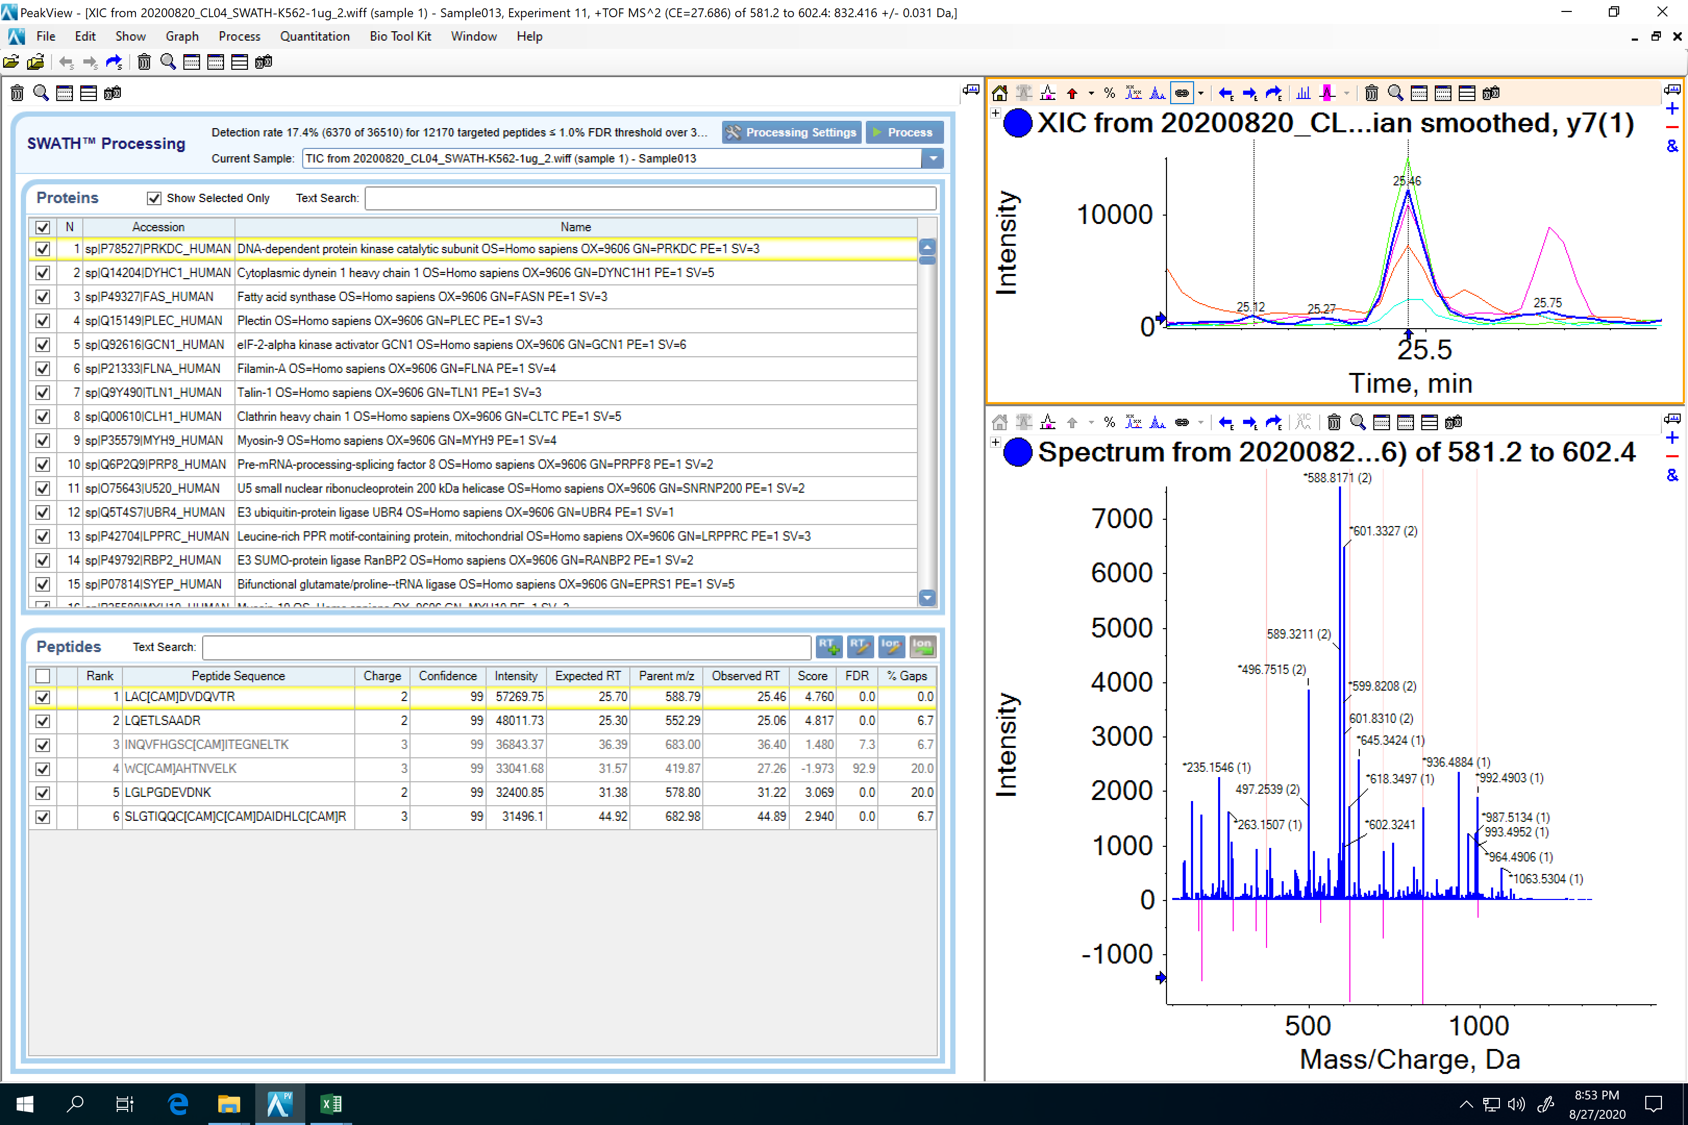

Protein identification and quantification from SWATH® data: Generation of PQPs
PeakView® Software
Notes:
Synonymous of attribute analytics in MAM but at MS/MS level

Slide 13
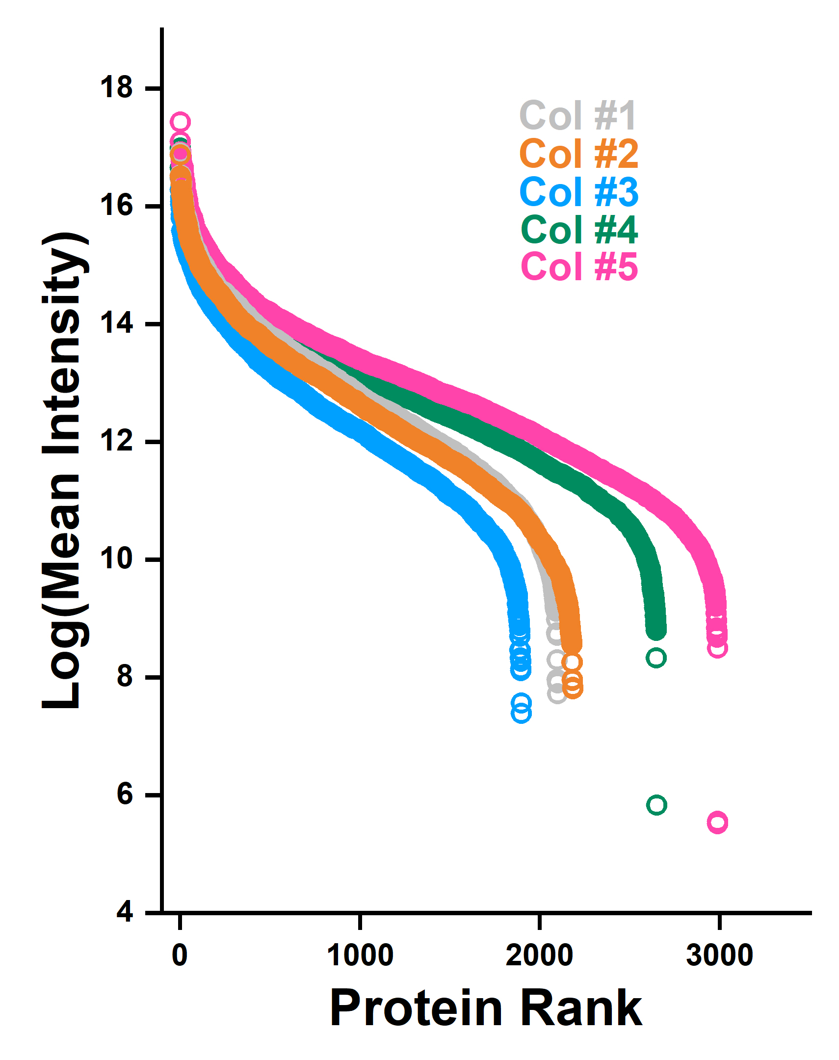
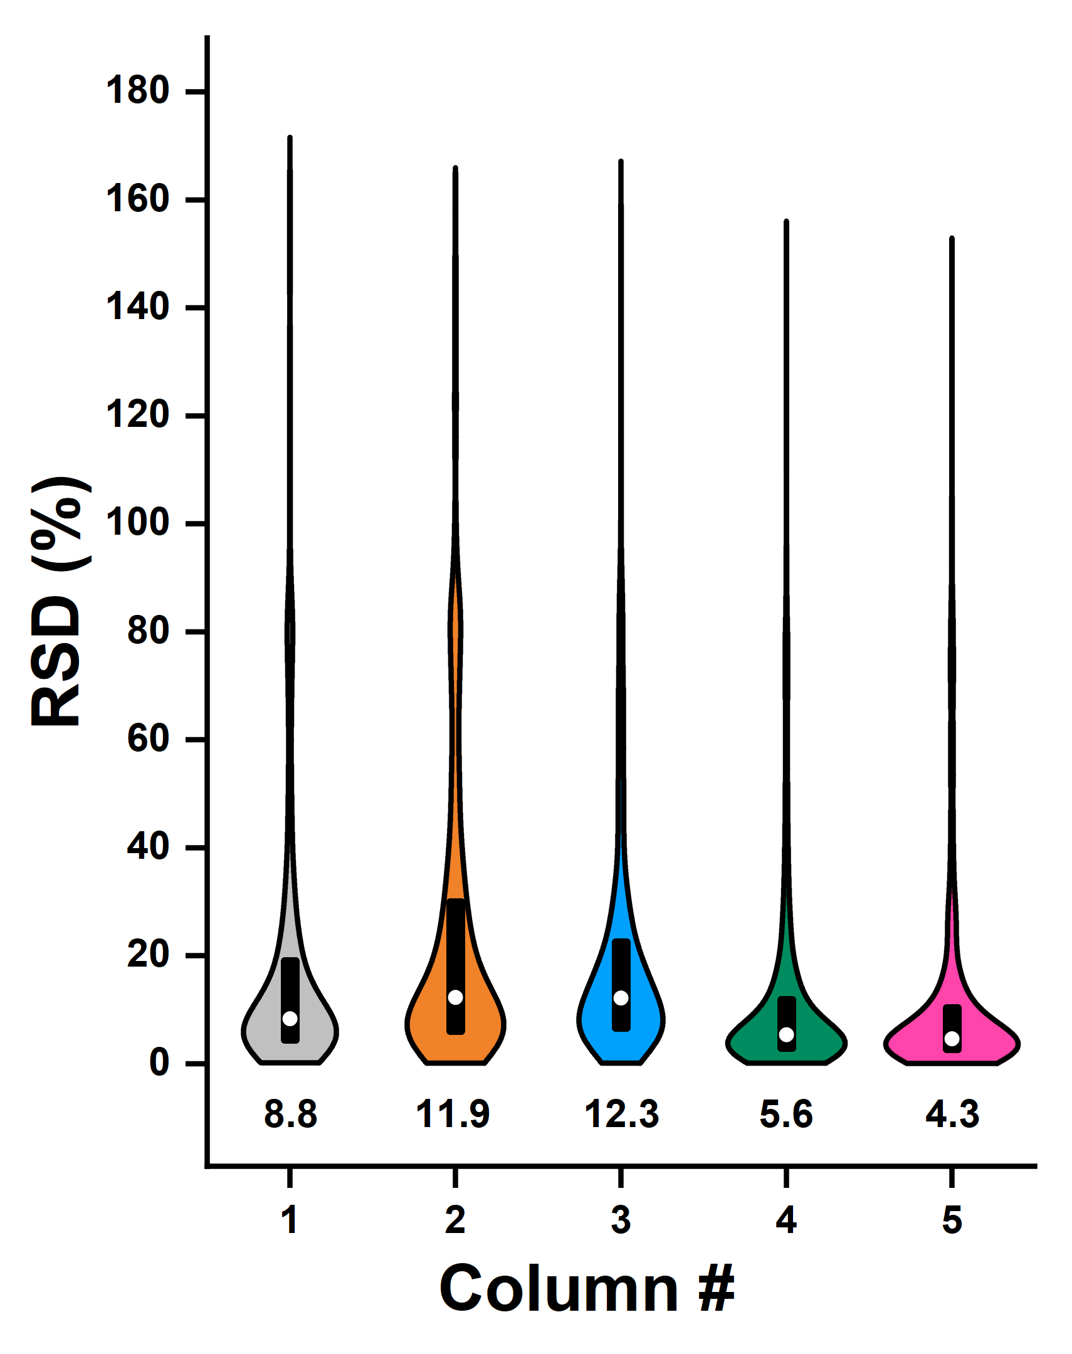
Column W300-25cm led to more sensitive quantification

Slide 14
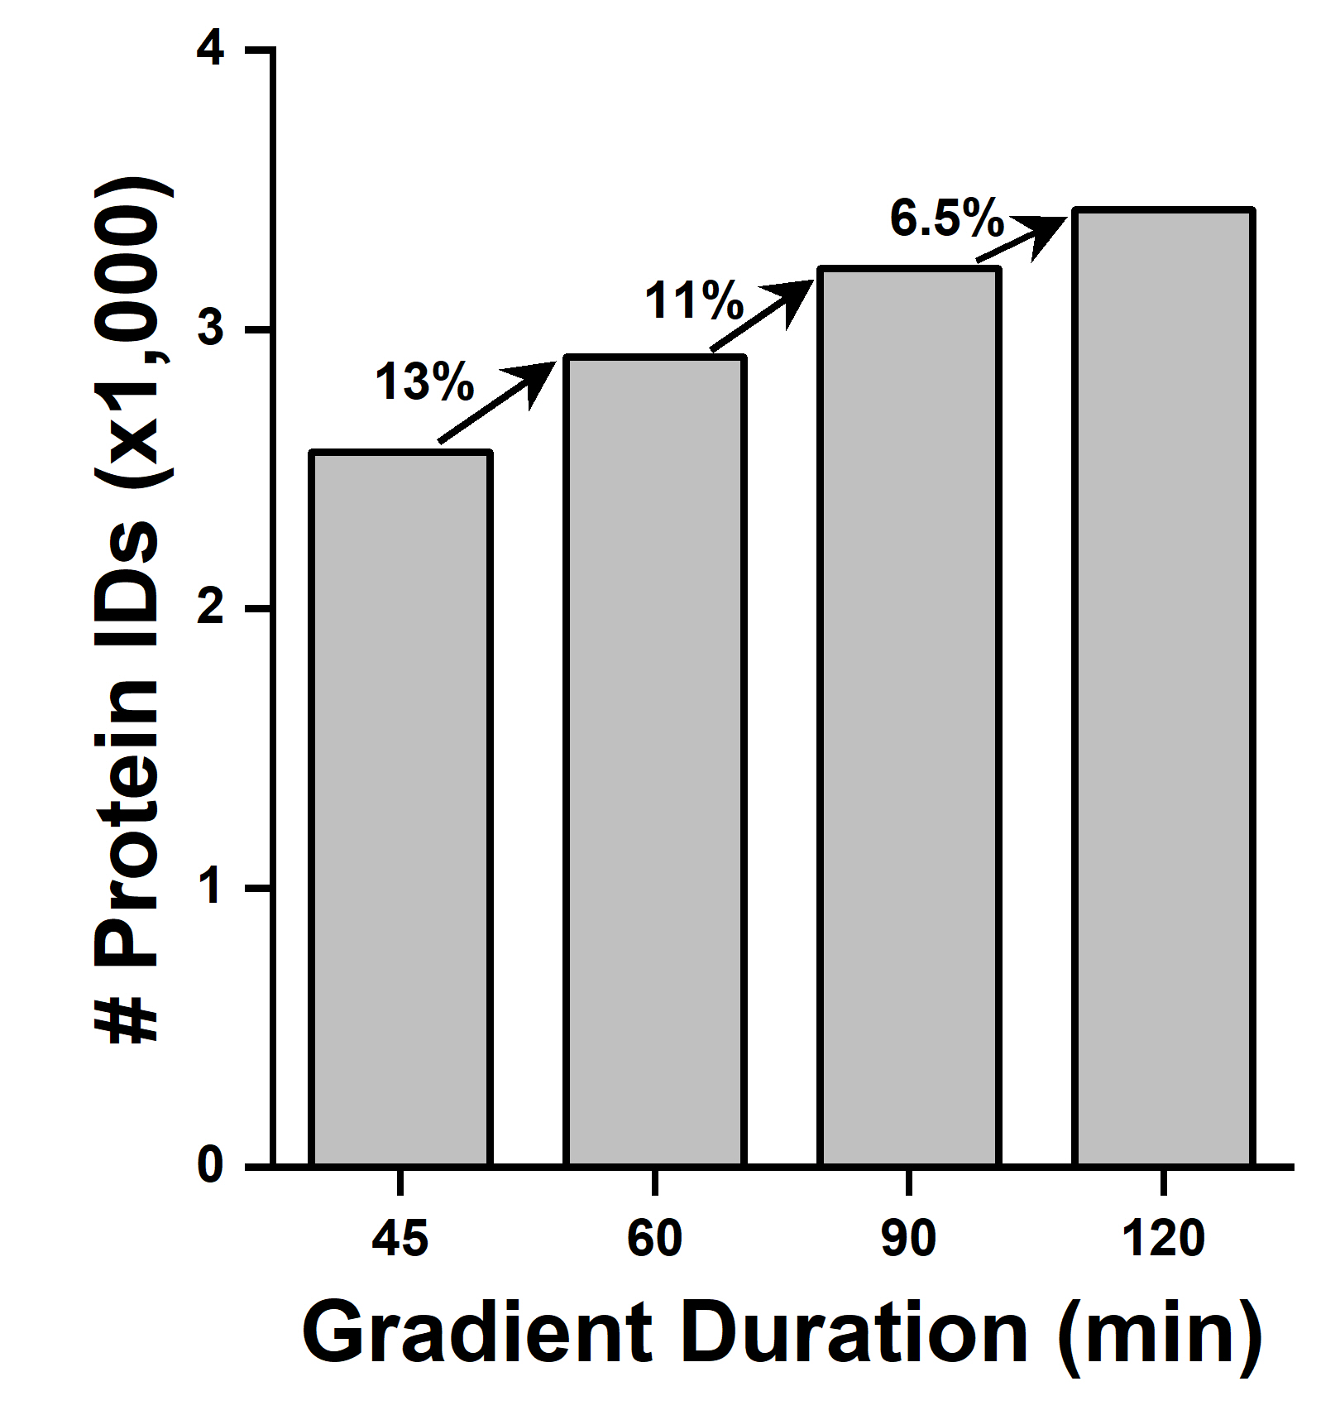
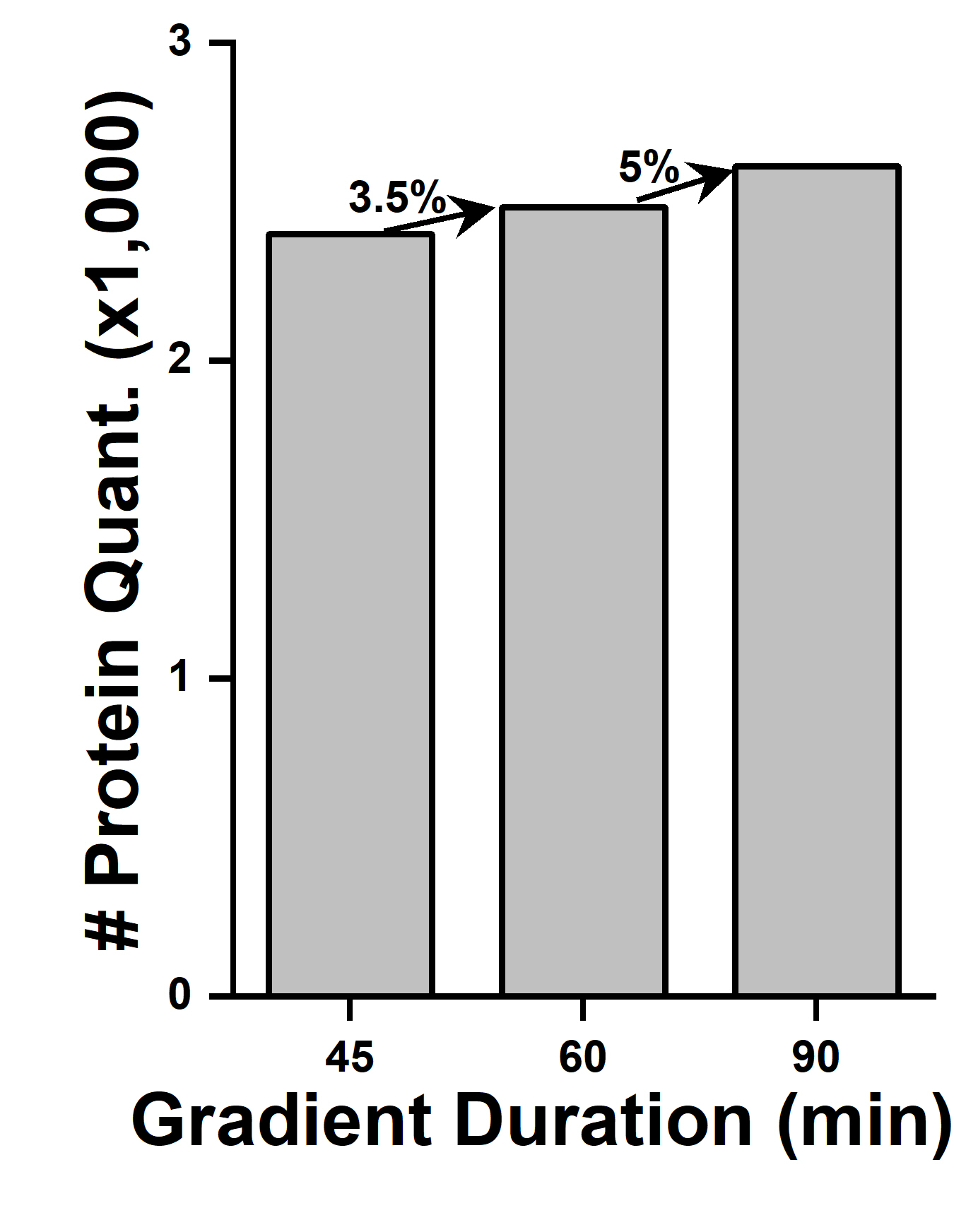
Gradient duration evaluation
DDA
SWATH

Slide 15
Designing a sensitive and controlled acquisition method for CAR-T proteomics
Mass Spectrometry
DDA
TOF-MS
MS/MS
IQ Metrics
Chromatography
s
Peptide Mix (e.g. PepCal)
FWHM
Ret. Times
Mass accuracy
Column:
Particle size
Length
m/z
m/z
PC
Acc. time & # Precursors
Col. energ. spread
m/z
Gradient duration
Complex Digest (e.g. K562)
Protein ID
Quant. performances
K562
Col #5
90 min gradient
SWATH®
m/z
m/z
SWATH window scheme

Slide 16
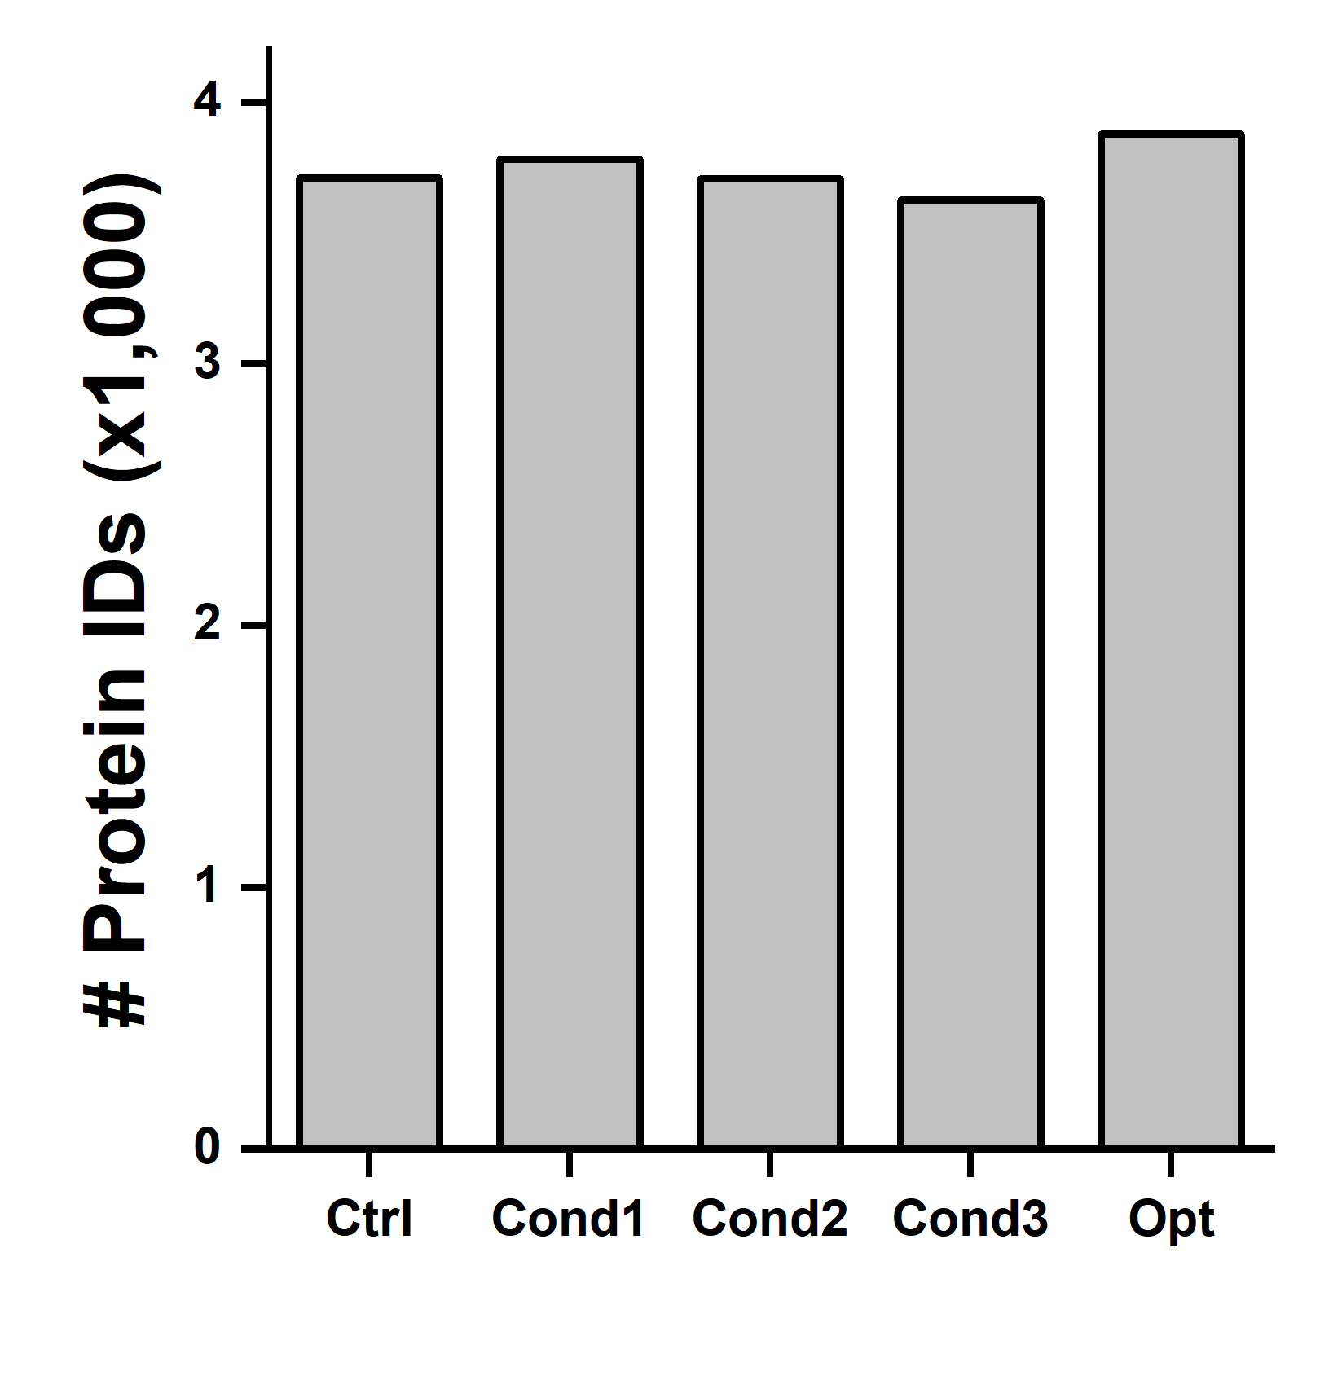
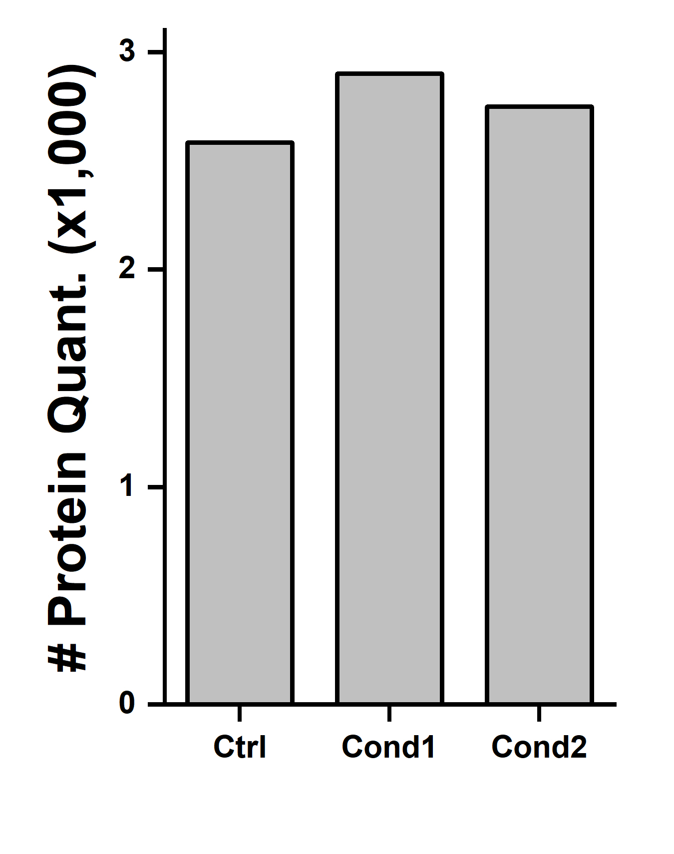
Revising the MS acquisition parameters
DDA
SWATH

Slide 17
Designing a sensitive and controlled acquisition method for CAR-T proteomics
Mass Spectrometry
DDA
TOF-MS
MS/MS
IQ/OQ Metrics
Chromatography
s
Peptide Mix (e.g. PepCal)
FWHM
Ret. Times
Mass accuracy
Column:
Particle size
Length
m/z
m/z
PC
Acc. time & # Precursors
Col. energ. spread
m/z
Gradient duration
Complex Digest (e.g. K562)
Protein ID
Quant. performances
K562
Col #5
90 min gradient
SWATH®
m/z
m/z
SWATH window scheme

Slide 18
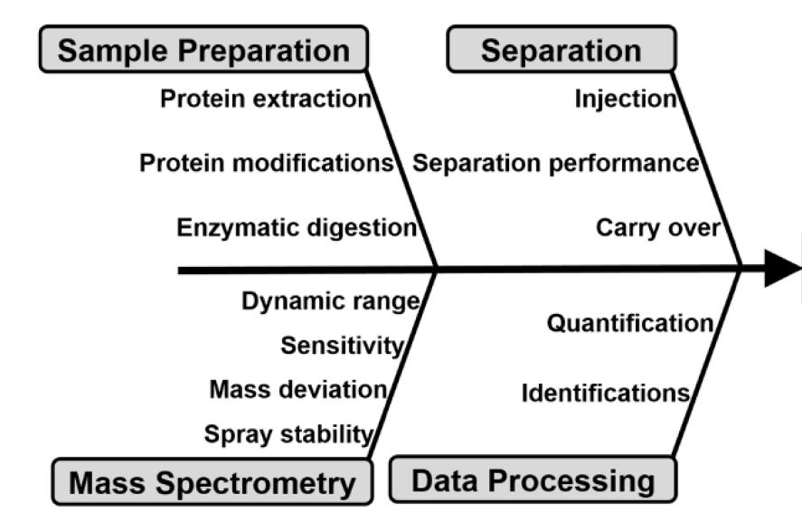
Technical Variability and Devising Method Control
Peptide Mixture
Commercial complex digest
(e.g. K562 digest)
Jurkat
Notes:
Quant and identficiations require a complex digest rather than peptide
Full SS reaquires a cell. While this comes with a caveat, in that will have variability when you express cells over time. Need to factor that in that biological variability will need to be addressed in a system suitability sample most likely. This is a huge challenge…

Slide 19
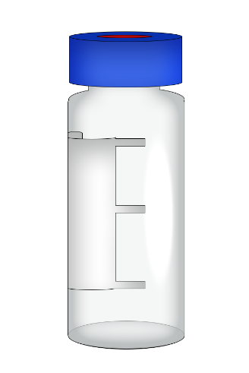

Instrument and measurement control design scheme
……
…….
K562 (D)
Sample
Sample
Sample
Sample
K562 (S)
K562 (S)
PepCal IQ
K562 (S)
Jurkat SS
PepCal IQ
Jurkat SS
PepCal IQ
t_{r}
Area
m/z Calibration
OQ
Use established extraction and digestion method
# of protein ID/quant.
Next Steps
  Refine digest
  Perform intermediate precision
  Set control strategy
K562 (D)
  # peptides ID
  # proteins ID
K562 (S)
  Select protein quant.
  PepCal spike in quant.

Slide 20
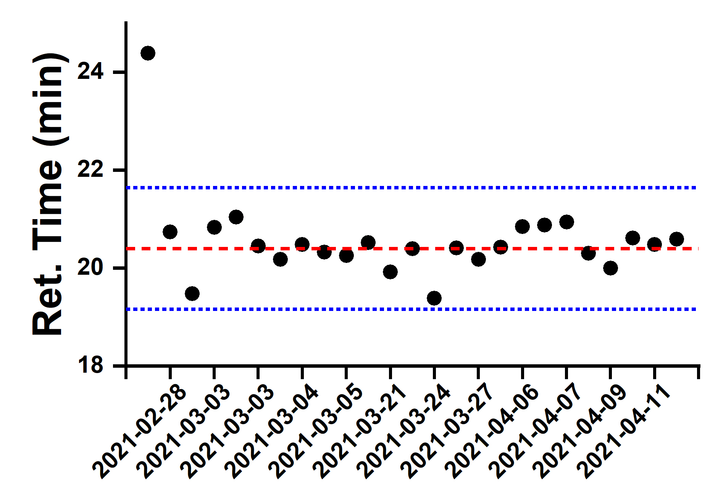
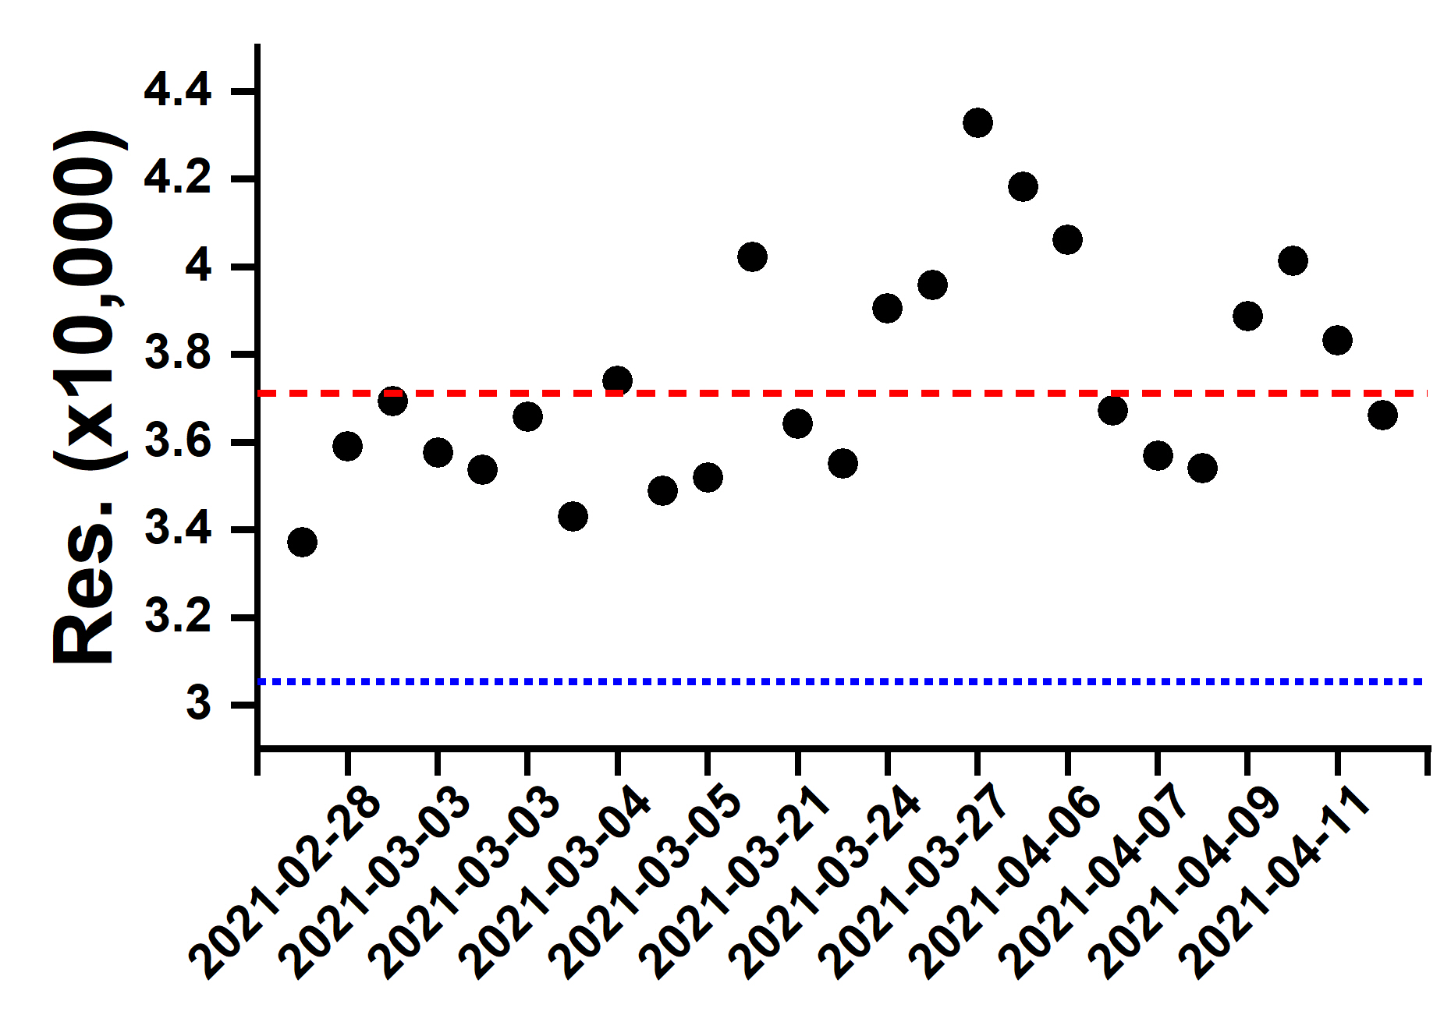
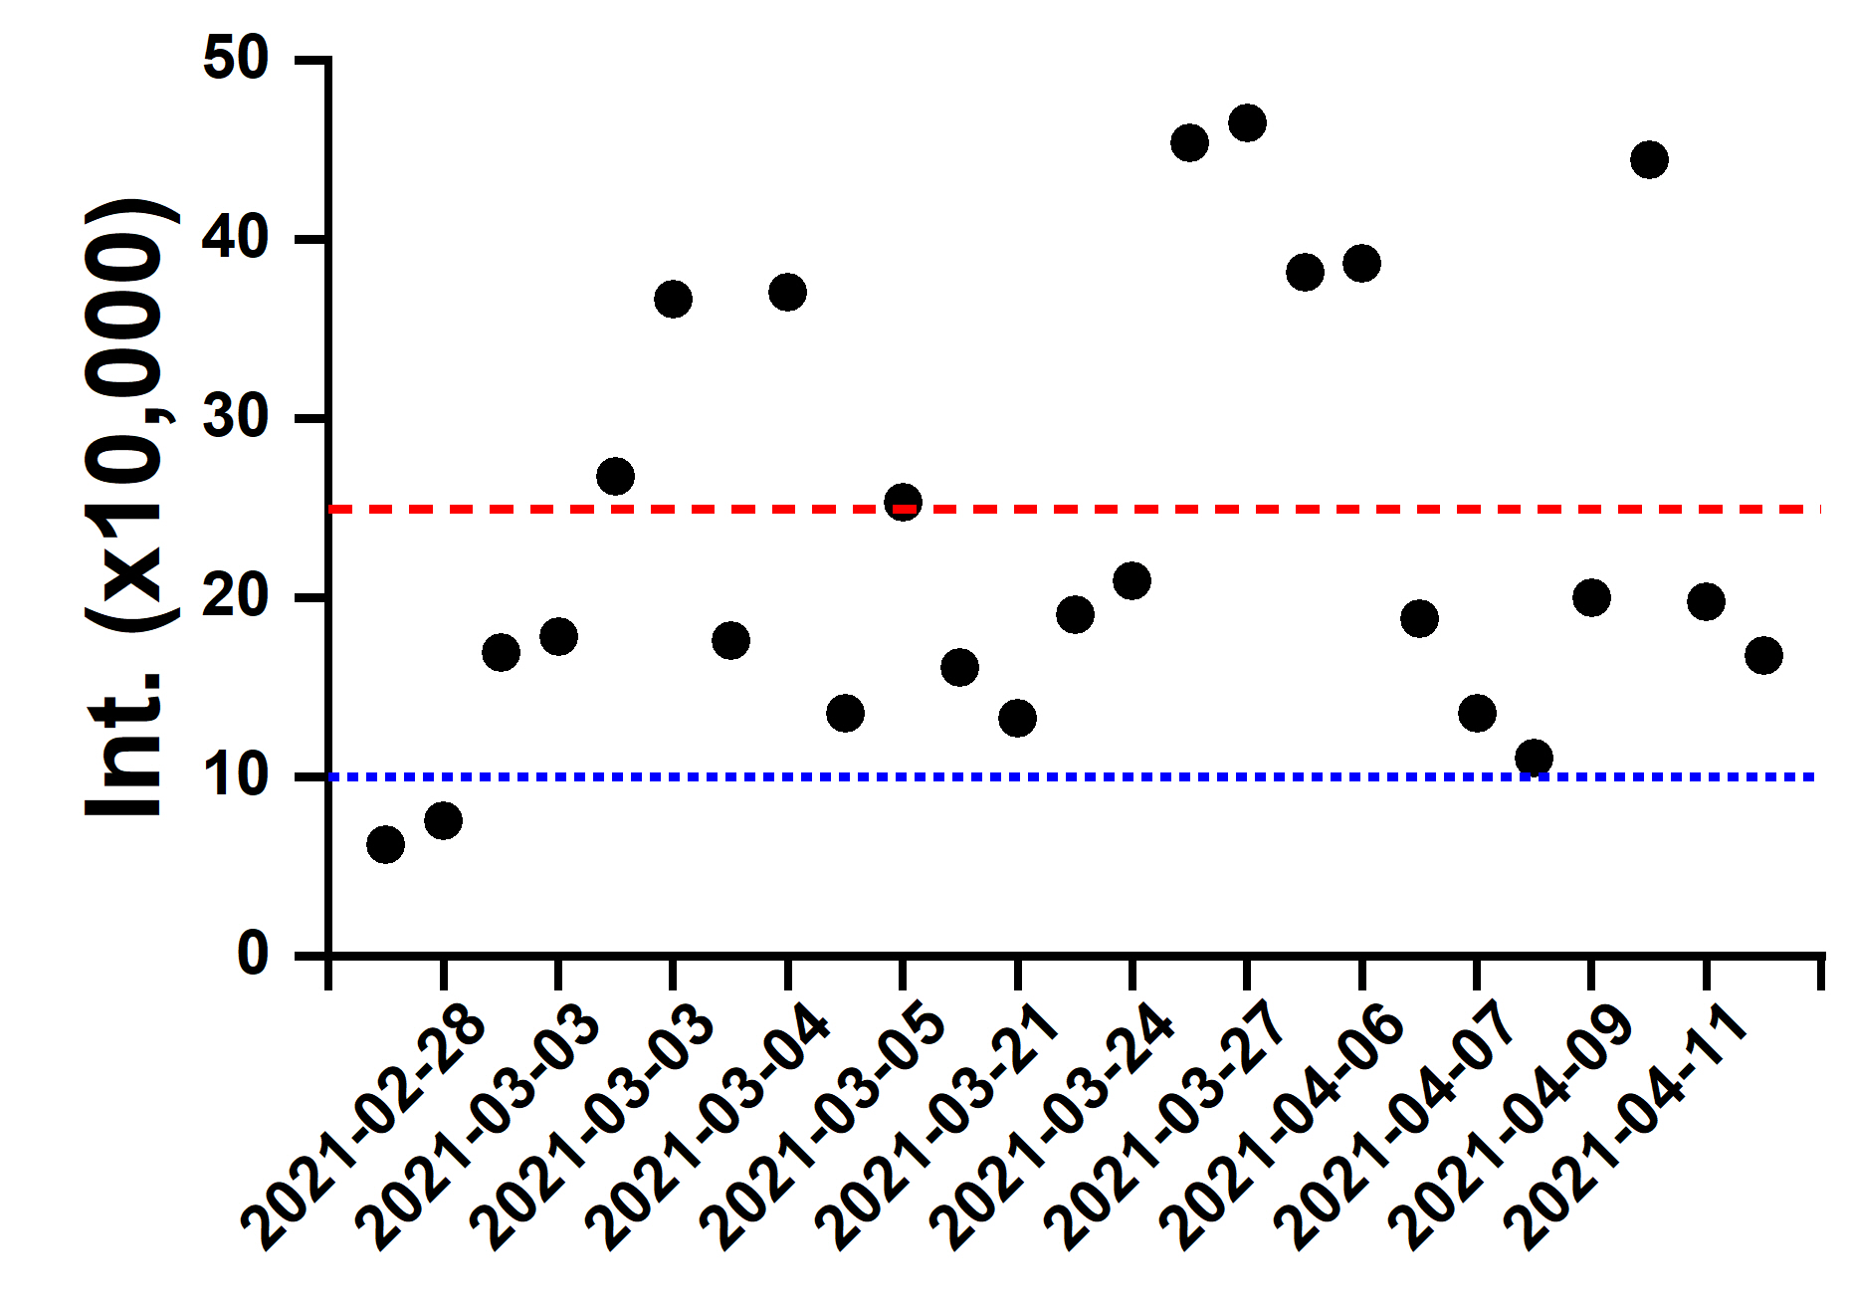
Some specific values for the simple IQ: PepCal Mix
Example for m/z 677

Slide 21
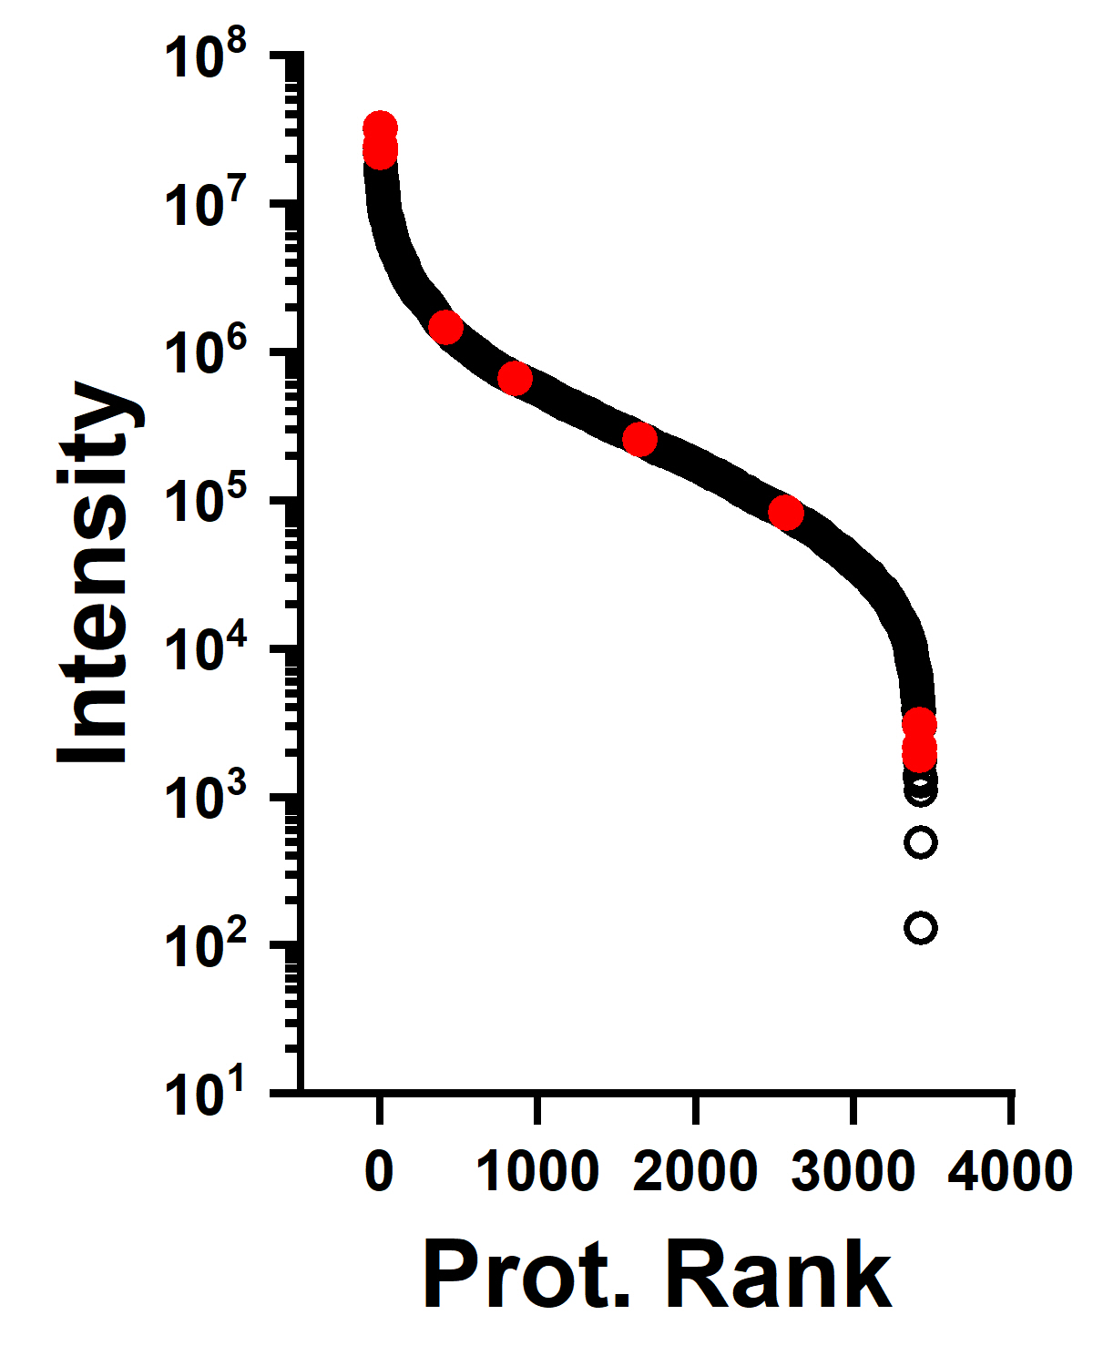
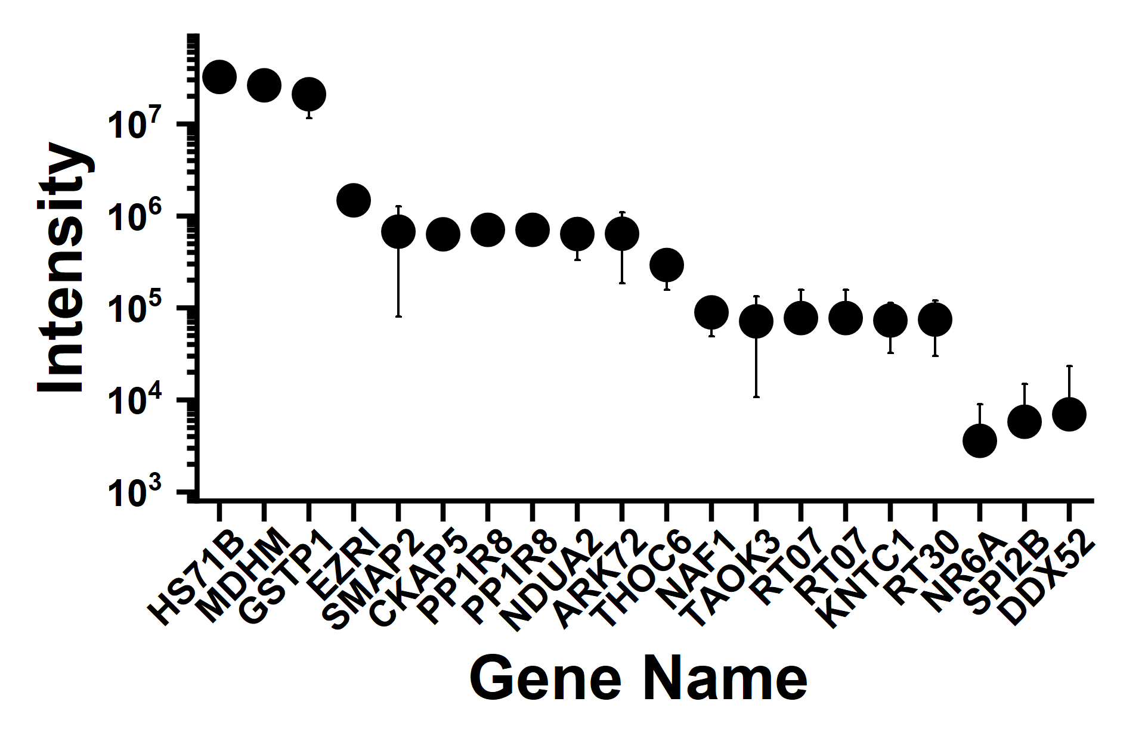
Some specific values for SWATH® on K562 (OQ)

Slide 22
Preliminary application of our method on Jurkat cells
500 ng of Jurkat digest measured
~2,500 proteins quantified
Jurkat data provide us with a baseline of proteins to compare with CAR expressing Jurkat cells

Slide 23
Steps to improve the proteomic workflow
Enhanced protein extraction
Scalable to low amounts of samples
→ Development of a model
Lombard-Banek, C. & Schiel J.E., Molecules, 2020

Slide 24
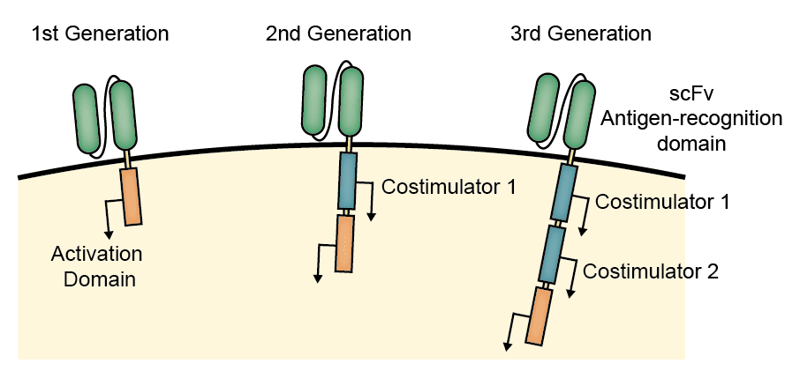

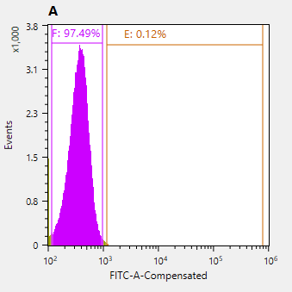
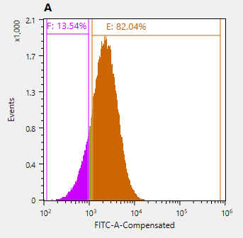
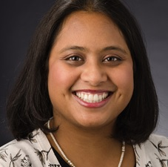
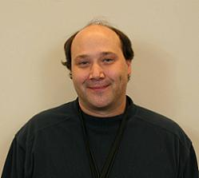
CAR-Jurkat model to advance analytics
Transduce
Express
Sort & Amplify
Transduced to express anti-HER2 CAR (Gen 2)
Future application of this model:
  Pre/post transduction
  MQAs assessment
  In process samples for process development/monitoring
  PQAs identification and product control
Before transduction
2nd sorting

Slide 25



Evaluating different sample preparation
Prot. Extr.
DIA
Extract.
Qual.
Quant.
IS
Compare
Global changes
SP3
STRAP
iST
Intensity
Log(p-value)
RT
Log2(FC)
HPRP
GO
MS1 | MS2 | RT
555.8 | 200.1 | 21
555.8 | 355.4 | 21
555.8 | 700.6 | 21
798.5 | 476.3 | 50
798.5 | 800.5 | 50
Specific enrichment
FASTA
….
….
DDA
DB Search
PQPs
Platform agnostic WF

Slide 26
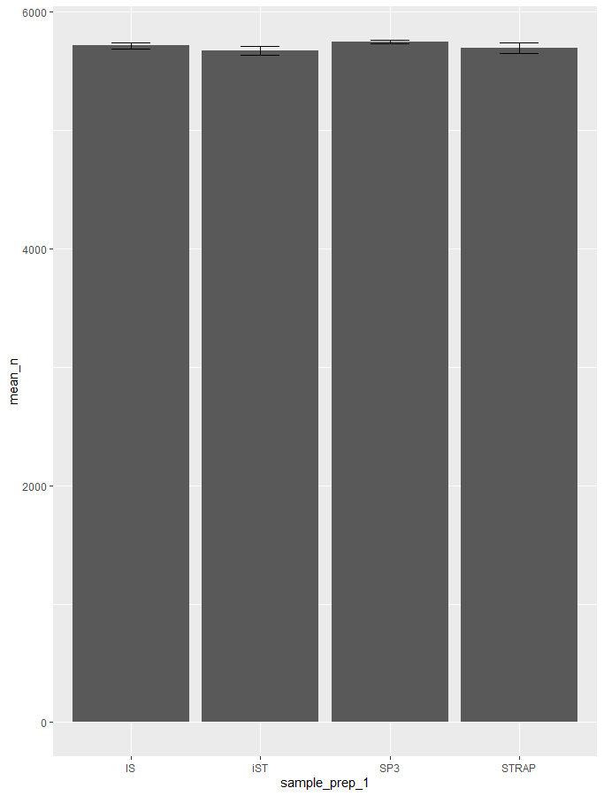
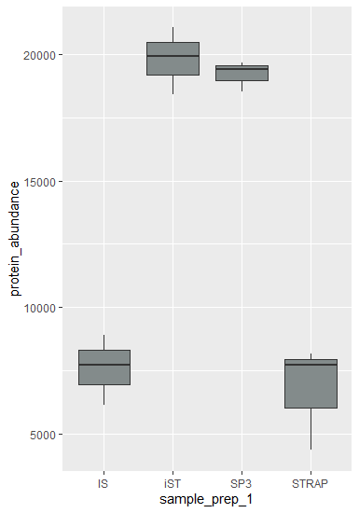
Preliminary evaluation of sample preparation methods
CAR quant.
# Protein Quant.
Protein Abundance

Slide 27
Conclusions
We have developed a sensitive quantitative acquisition method
We have established a measurement control strategy to collect large scale proteomic data for biotherapeutics
We are evaluating the protein extraction/digestion methods:
  # of peptides and protein identified/quantified
  Identification and coverage of the CAR
  Preparation induced modifications (e.g. M oxidation)
  Specific proteins: Jurkat functional markers (e.g. CD3, CD4, CXCR4, CD69), inflammatory proteins
Test approaches on small numbers of cells (~10,000)
Disclaimer: Instruments identification is not intended to imply recommendation or endorsement by the National Institute of Standards and Technology

Slide 28


Acknowledgements
Schiel’s laboratory
  John Schiel
  Trina Mouchahoir
  Kat Yandrofski
  Erdem Coskun
  John Giddens
  Josh Powers
John Elliott’s laboratory
  Edward Kwee
  Sumona Sarkar
SCIEX
  Kerstin Pohl
  Melanie Juba
  David Colquhoun
  Elliott Jones

